Slide 1
The Atomic Structure History of atom

Slide 2
Beginning
Man has always wanted to know and understand how nature works.
It is in his nature to ask questions and then to seek the answers.
One such question is “What is the nature of matter that makes up the physical universe?”

Slide 3
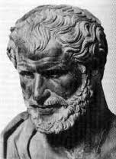
Start of the Quest for Answers
Democritus – a Greek natural philosopher
In 400 B.C. he did a mind experiment in an attempt to explain the nature of matter.
His question was “If I take an object and repeatedly cut it in half, will there be a point that it cannot be cut any smaller?”
He decided the final particle is “an atom”

Slide 4
Democritus’s Atomic Theory
All matter consists of invisible particles
called atoms (from the Greek “Atomos”
for indivisible).
Atoms are indestructible.
Atoms are solid but invisible.
Atoms are homogenous.
Atoms differ in size, shape, mass, position, and arrangement.

Slide 5
Democritus’s Atomic Theory
The nature of those particles gave rise to the different states of matter:
Solids are made of small, pointy atoms (gives solids rigidity)
Liquids are made of large, round atoms (allowed the atoms to flow over each other).
Gases: Particle move freely
->Oils are made of very fine, small atoms that can easily slip past each other (the reason oils felt slippery).

Slide 6
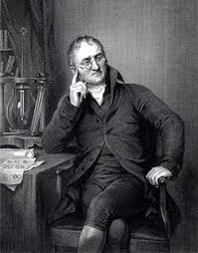
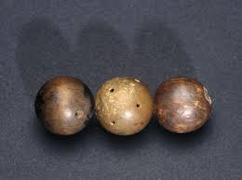
John Dalton
He agreed with Democritus concerning the structure of the atom (solid and indivisible)

Slide 7
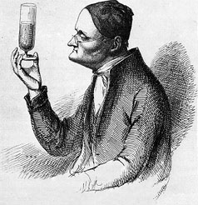
John Dalton
Brought Democritus’s Atomic Theory into the realm of scientific knowledge, instead of being relegated to the whims of the human mind.
Presented his theory to the world in 1803.

Slide 8
John Dalton’s Theory
All matter is made up of atoms
All atoms of the same element are identical. And all atoms of different elements are different
Atoms can not be created nor destroyed only rearranged. (law of conservation of matter)
Atoms combine in fixed ratios to form compounds. (law of definite proportions)
Atoms combine in different ratios to form different compounds. (law of multiple proportions)

Slide 9
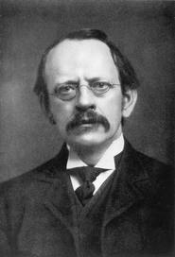
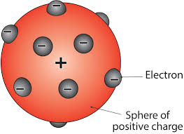
J.J. Thomson
He discovered the existence of what he called electrons (negatively charged particles).
He described the atom as being like “plum pudding”. The electrons were simply stuck on the outside of the solid sphere that is the atom.

Slide 10
J.J. Thomson’s Experiment
Using a cathode ray tube, he projected a beam of particles through a magnetic field and observed how the particles were deflected.

Slide 11
J.J. Thomson
His discovery was announced in 1897.
With that announcement, one more piece of information was added to the puzzle of the nature of matter.

Slide 12
Still More to Find
With Thomson’s discovery, it was realized there were more to an atom than was first thought.
If electrons had a negative charge, why are atoms electrically neutral?
This means there must be opposite charges in an atom!

Slide 13
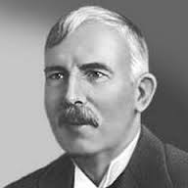
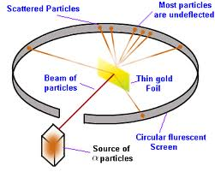
The Quest Continues
Ernest Rutherford –
He was not satisfied with the current theory of the atom.
He projected a beam of positive charged alpha particles at a thin sheet of gold.
Most particle passed straight through, and some particle deflected. This implied there must be positive charge in atom structure of the atom.
He found nucleus had positive charge.
He published his results in 1911

Slide 14
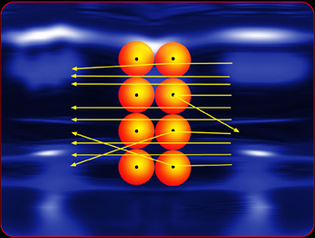
Ernest Rutherford
Based on his results, Rutherford announced the atom was mostly empty space with a dense positively charged at the center.

Slide 15
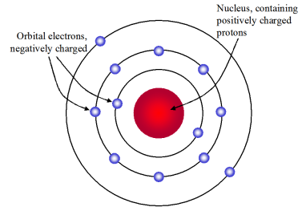
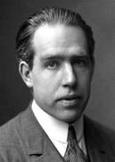
Niels Bohr Theory of an atom
In 1913, Niels Bohr proposed an atom was like a tiny solar system (the nucleus was like the sun and the electrons like the planets).

Slide 16
Niels Bohr theory of an atom
Electrons travel in discrete orbits defined by their angular momentum.
This made it possible to calculate the energy levels of electrons and the frequency of the light emitted when electrons returned to the home state.

Slide 17
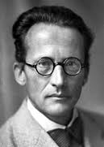
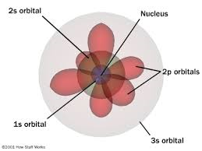
Erwin Schrödinger
He developed mathematical equations that described the motion of electrons. This led to the development of the idea of an electron as a cloud instead of a strict orbit.

Slide 18
Erwin Schrödinger
His work was announced in 1926.

Slide 19
James Chadwick
Along with other scientists, Chadwick realized the atomic mass of an element, was often twice what it should be.
This implied there was other particles in the nucleus.
This led to Chadwick conducting an experiment that proved the existence of neutrons.

Slide 20
James Chadwick
In 1932, he proved the existence of the neutron, a particle having the same mass as a proton and no charge.

Slide 21
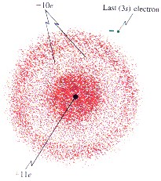
Current Theory
The current atomic theory is closely aligned with that of Erwin Schrödinger. The orbits of electrons are seen more as an area of high probability to find an electron rather than as a discrete orbit.

Slide 22
Recap
Our view of the structure of the atom has changed over time as our ability to examine it has improved.

Slide 23
The End?
We are near the limit of technology to reveal the secrets of the universe.
Does that mean we know everything about the structure of an atom
May be not!
In many ways, the journey may just beginning!

